Slide 1
Data Storytelling - Latest Data Science Salaries
Fatih Demiroz
Notes:
Hi and welcome.
In this presentation, I will demonstrate my data storytelling skills.
My presentation is about latest data science salaries

Slide 2

Uncertainty in DS Salaries
Problem: Uncertainty about DS salaries
Higher salary/income Expectations
What is a realistic salary?
Notes:
The Data science field has been attracting many people, including us, the Springboard students.
There are several reasons why people are trying to get into data science jobs.
Data science offers better career trajectory,
Higher salary/income
Higher job satisfaction.
There is uncertainty about DS salaries.

Slide 3
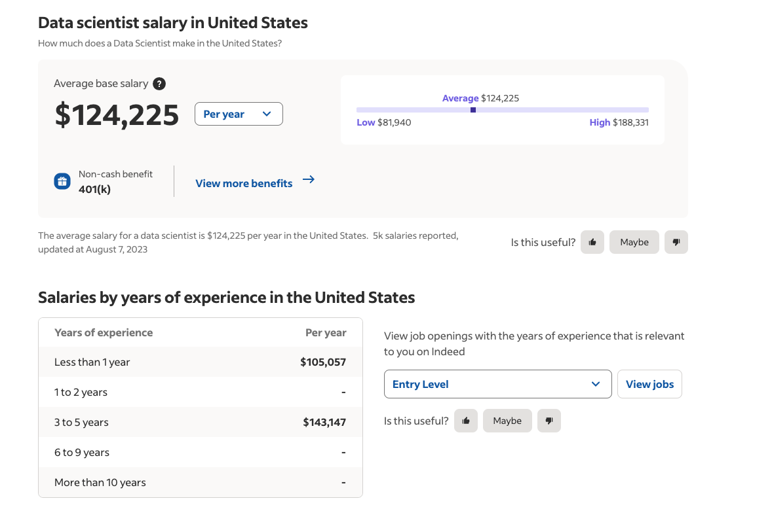
Data Science Salaries - What to Expect
Wide array of jobs/roles
Broad salary range
https://www.indeed.com/career/data-scientist/salaries
Notes:
A search on the internet will show a wide range of DS jobs and salaries.
The question I try to address in this presentation is how much salary should we expect?

Slide 4
Why Examine Salary Data: Negotiations
What is the value of your skills in the market?
What is your Minimum Acceptable Salary (MAS) in negotiations?
Notes:
Why is it important that we learn about DS salaries?
One of the most important reasons is negotiations.
When we go out to the job market, interview companies, and get job offers, we need to know the value of our skills in the market.
Companies will always want to offer the minimum salary for the job and we will always want to maximize our salary.
Determining the Minimum Acceptable Salary (MAS) for the positions we apply is a crucial step in successful salary negotiations.
In this presentation, I analyze Data Science salary data I obtained from Kaggle.

Slide 5
Goal:
1- to provide a snapshot of Data Science salaries for different type of
Experience levels
Company size
2- Help you determine your MAS

Slide 6
Data: Recent Data Science Salaries (Kaggle)
11 columns x 2238 rows (U.S. only)
Columns used:
Salary
Company size
Experience level
Job title (reduced from 86 to 21)
https://www.kaggle.com/datasets/iamsouravbanerjee/data-science-salaries-2023

Slide 7
Median, Mean, and Std Salary for Each Exp. Level
 | Experience Level
 | Entry | Mid | Senior | Executive
Small Comp. | $90,000 $86,854 $28,400 | $107,000 $103,600 $61,600 | $120,000 $146,780 $63,900 | $200,000 $249,000 $14,142 | Median Mean std
Medium Comp. | $94,035 $103,000 $44,000 | $130,000 $136,000 $53,500 | $160,000 $167,000 $59,600 | $200,000 $199,000 $63,00 | Median Mean std
Large Comp. | $86,000 $108,377 $59,200 | $113,000 $136,000 $41,500 | $169,000 $167,000 $58,600 | $290,000 $280,000 $53,900 | Median Mean std

Slide 8
Job Titles - Experience Level
Most common…
Entry Level Jobs: Data Analyst, Data Engineer, Data Scientist
Mid Jobs: Data Engineer, Data Analyst, Data Scientist
Senior Jobs: Data Scientist, Data Engineer, Data Analyst, ML Engineer
Executive: Data Engineer, Data Scientist, Director of Data Science

Slide 9
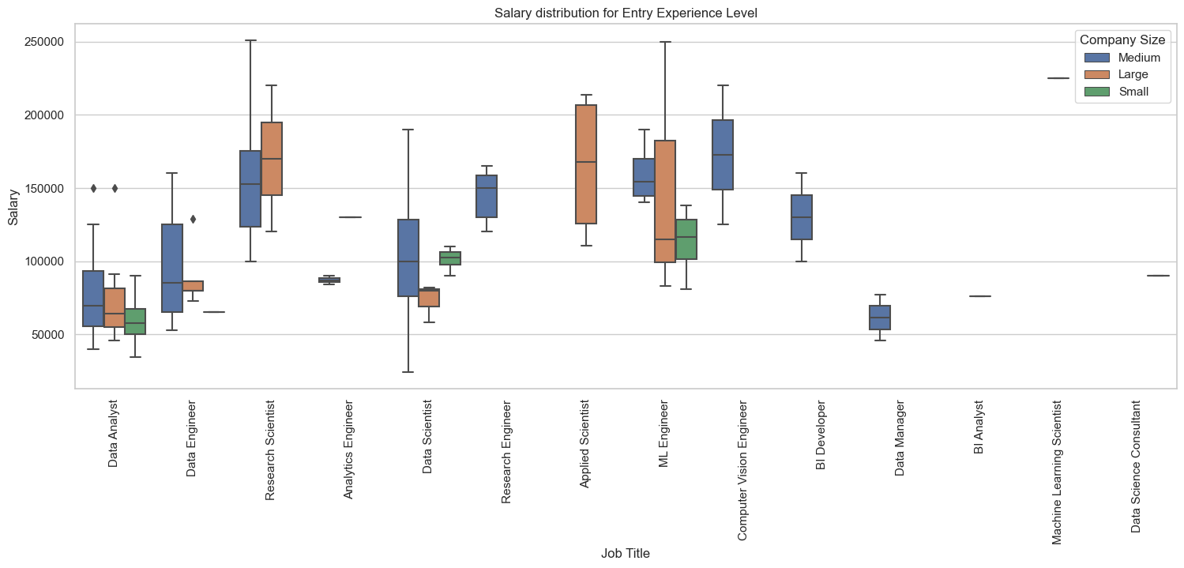

Slide 10
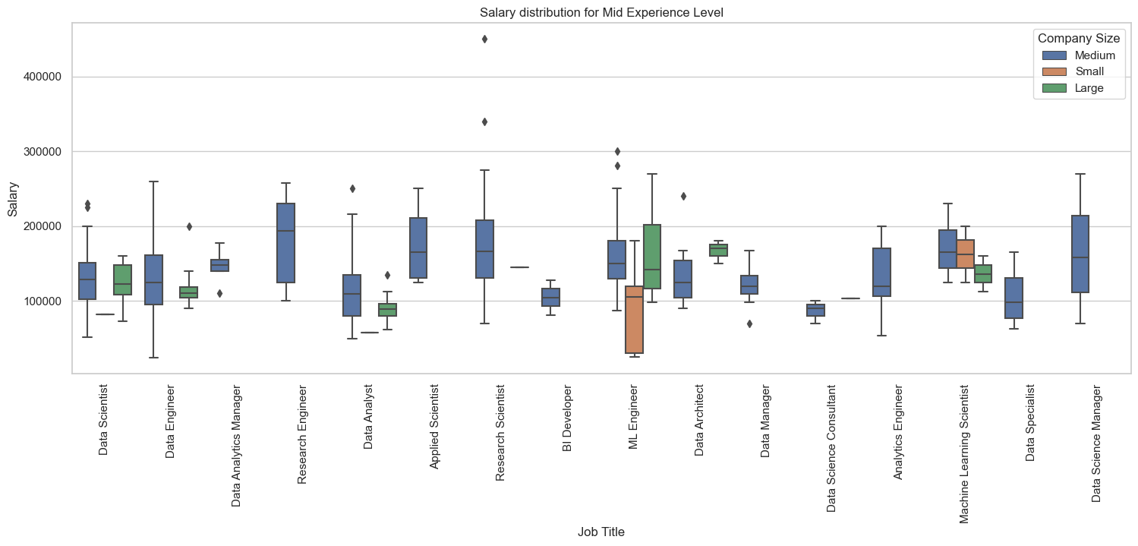

Slide 11
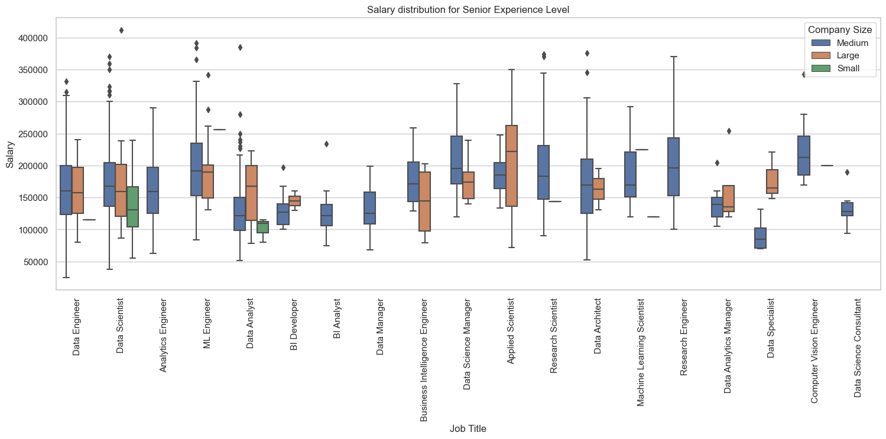

Slide 12
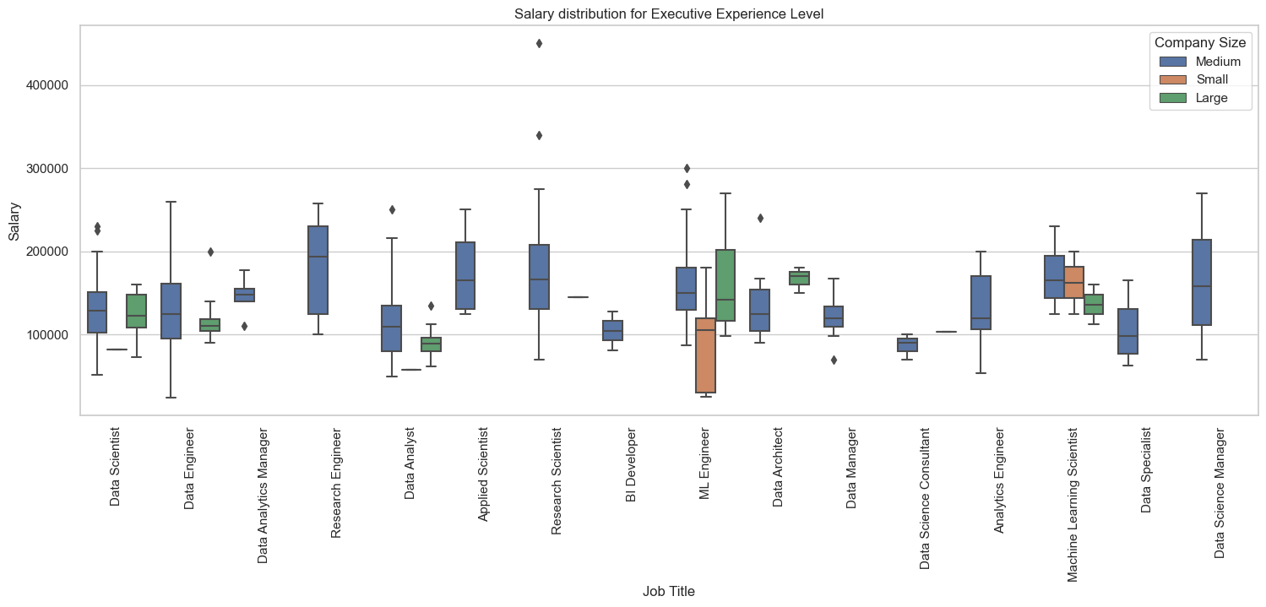

Slide 13
Conclusion
 | Salary Range (median) | Company Size | Best Paying Job Title
Entry | $86k - $94k | Large/Medium | Scientist, Computer Vision Eng. ($170k)
Mid | $105k - $130k | Medium | Research Engineer ($190k)
Senior | $120k - $160k | Medium | Computer Vision Eng. ($210k)
Exec. | $190 - $287k | Medium | Research Engineer ($195k)

